Slide 1

April 2020
Tesla Credit Analysis
Alex Giroux, David Gringeri, Tristan Lalor, Ryan Landgraf, Maria Pitari

Slide 2
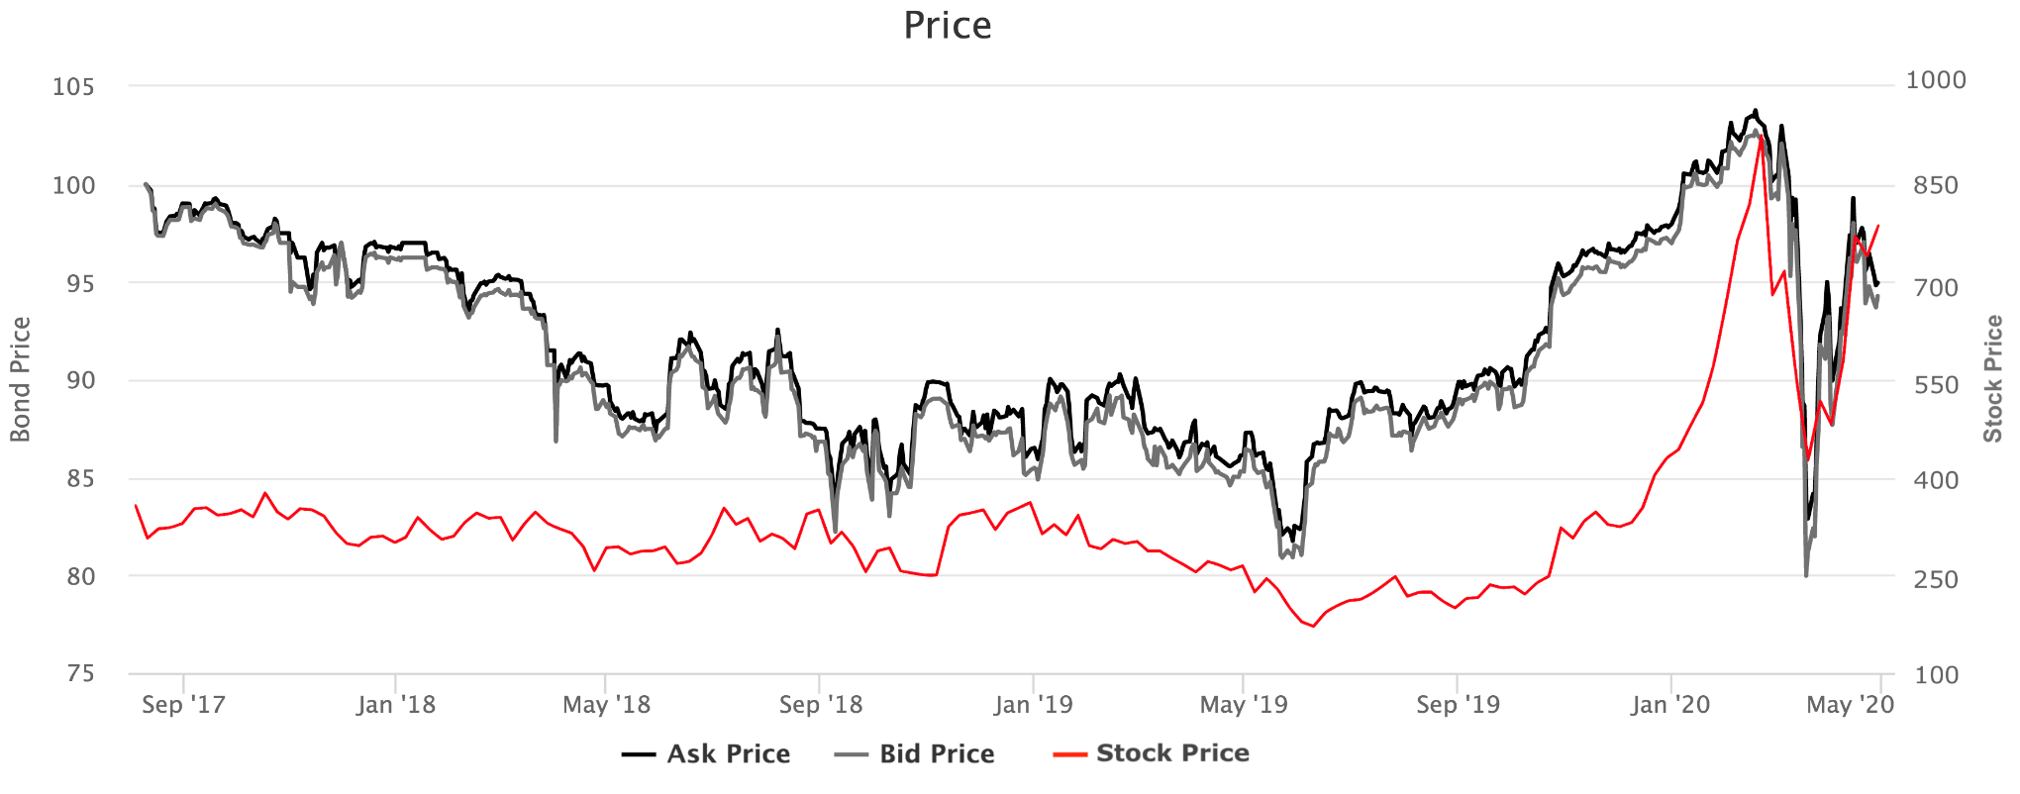
Executive Summary
Stock
TSLA 5.3% 2025 Note vs. TSLA Stock
Industry: Automotive, Energy Storage & Production
NASDAQ: TSLA
Market Cap: $127B
52-week high: $968.99
52-week low: $176.99
Bond
Type: Senior Unsecured Callable
Moody's: Caa1
S&P: B-
Coupon: 5.3%
Yield (Wst): 6.547
Issue date: 8/18/2017
Maturity: 8/15/2025
Key Takeaways
Tesla has sufficient cash reserves to withstand Coronavirus disruption
Tesla has a technological lead in electrification that provides flexibility to scale back capital expenditure
Debt maturing prior to 2025 will likely be refinanced or converted into equity
Recommendation: BUY

Slide 3
Table of Contents
Tesla Business Overview
Industry Overview
Macroeconomic Analysis
Tesla Credit Analysis
Appendix

Slide 4
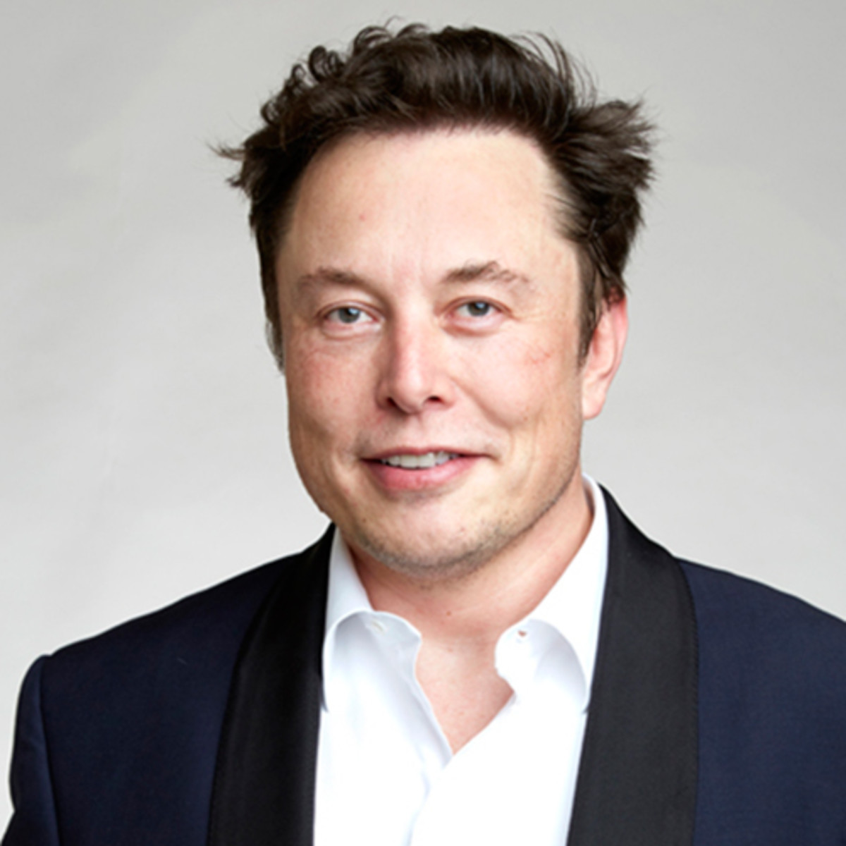

Tesla Business Overview
Business Overview
Key Executives
Business Description
Founded in 2003, Tesla designs, manufactures, and markets high-performance, technologically advanced electric cars and solar energy generation and energy storage products.
Leader in solar power and storage innovation with the Solar Roof and Solar Wall technologies
Unlike other automakers, Tesla is also an information technology company that tracks large amounts of consumer data and is a leader in artificial intelligence and self-driving technology.
Elon Musk, Head of Product Development
Founder of PayPal, SpaceX and Tesla Motors.
Studied Physics and Business at the University of Pennsylvania
Oversees development of all sedan type EV's including the new Roadster and CyberTruck
Revenue by Product
Revenue by Region
Zachary Kirkhorn, Chief Financial Officer
Earned degree in Mechanical Engineering and Economics at the University of Pennsylvania and an MBA from the Harvard Business School
Responsible for controlling operational financing, as well as new developments and company expansion

Slide 5
Tesla Business Overview
Historical and Projected Financial Performance
Stock
Summary Financials
Ticker: TSLA
Price: $686.72
Market Cap: $127B
Beta: 1.40
52 Week High: $176.99
52 Week Low: $968.99
Income Statement | FY17 | FY18 | FY19 | FY20 | FY21 | FY22 | FY23 | FY24 | FY25
Total revenues | 11,759 | 21,461 | 24,578 | 23,387 | 26,855 | 31,141 | 35,889 | 41,559 | 48,165
% Growth | - | 82.51% | 14.52% | -4.85% | 14.83% | 15.96% | 15.25% | 15.80% | 15.90%
Gross profit | 2,223 | 4,042 | 4,069 | 3,841 | 4,849 | 6,139 | 7,667 | 9,483 | 11,681
% Gross margin | 18.90% | 18.83% | 16.56% | 16.42% | 18.06% | 19.71% | 21.36% | 22.82% | 24.25%
Loss from operations (EBIT) | -1,632 | -388 | -69 | 216 | 625 | 1,397 | 2,381 | 3,569 | 5,068
% Operating margin | -13.88% | -1.81% | -0.28% | 0.92% | 2.33% | 4.48% | 6.63% | 8.59% | 10.52%
Net loss | -2,241 | -1,063 | -775 | -567 | -138 | 508 | 1367 | 2,344 | 3,497
Cash Flow Statement
D&A | 1,636 | 1,901 | 2,154 | 2,156 | 1,490 | 1,631 | 1,787 | 1,958 | 2,146
Capital Expenditure | -3,415 | -2,101 | -1,327 | -1,327 | -1,460 | -1,606 | -1,766 | -1,943 | -2,137
Net change in cash and cash equivalents | 198 | 312 | 2,506 | -140 | 2,127 | 1,534 | 3,378 | 5,856 | 6,106
Balance Sheet: Key Line Items FY2020 Expected
Assets |  |  | Liabilities
Cash and cash equivalents | 6,569 |  | Accounts payable | 3,630
Accounts receivable, net | 1,266 |  | Accrued liabilities and other | 2,778
Inventory | 3,418 |  | Deferred revenue | 1,112
 |  |  | Current portion of debt and finance leases | 1,707
Total current assets | 11,936 |  | Total current liabilities | 10,094
Property, plant and equipment, net | 10,362 |  | Debt and finance leases, net of current portion | 11,362
Operating lease vehicles, net | 2,785 |  | Other long-term liabilities | 2,655
Solar energy systems, net | 5,817 |  | Total liabilities | 25,289
Total assets | 33,853 |  | Total stockholders' equity | 8,565

Slide 6
Tesla Business Overview
Historical Capital Structure
For FY2019
Debt Outstanding (in $ millions)
Shares Outstanding | 181
Price per Share | 418
Market Capitalization | 75,717.7
Total Debt² | 13,419
Total Capital | 150,130.17
% Equity | 91.06%
% Debt | 8.94%
 | Unpaid Principal Balance | Long-Term Net Carrying Value as of FY2019
1.25% Convertible Senior Notes due 2021 | 1,380 | 1,304
2.375% Convertible Senior Notes due 2022 | 978 | 902
2.00% Convertible Senior Notes due 2024 | 1,840 | 1,383
5.30% Senior Notes due in 2025 | 1,800 | 1,782
Credit Agreement | 1,727 | 1,586
0% Convertible Senior Notes due 2020 | 103 | -
Solar Bonds and other Loans | 70 | 53
Total recourse debt | 7,898 | 7,010
plus: non-recourse debt | 4,594 | 3,392
Total | 12,492 | 10,402
Total Debt / Equity¹ Ratio
Net Debt / Equity¹ Ratio
¹Based on year-end market capitalization, ²Includes short-term and long-term portions of debt and finance leases

Slide 7
Table of Contents
Tesla Business Overview
Industry Overview
Macroeconomic Analysis
Tesla Credit Analysis
Appendix

Slide 8
Industry Overview
Automotive Industry Overview
The automotive industry is highly cyclical. Current macroeconomic headwinds will negatively impact auto sales in the upcoming quarters.
Due to regulatory pressure and shifting consumer preferences, the industry will continue to move towards vehicle electrification.
The global EV market is estimated to grow from 3.27M units in 2019 to 26.95M units in 2030, at a CAGR of 21.1%.
Total U.S. Vehicle Sales (Millions of Units)
Global EV Sales: 1Q18 vs. 1Q17
Regulation
China will extend state subsidies and tax breaks for EV’s until 2022.
British Columbia announced legislation for the most stringent ZEV mandate worldwide: 30% ZEV sales by 2030 and 100% by 2040.
Europe’s 13 top auto manufacturers will face more than €14.5 billion in fines if they don’t meet fleet-average CO2 emission standards.

Slide 9
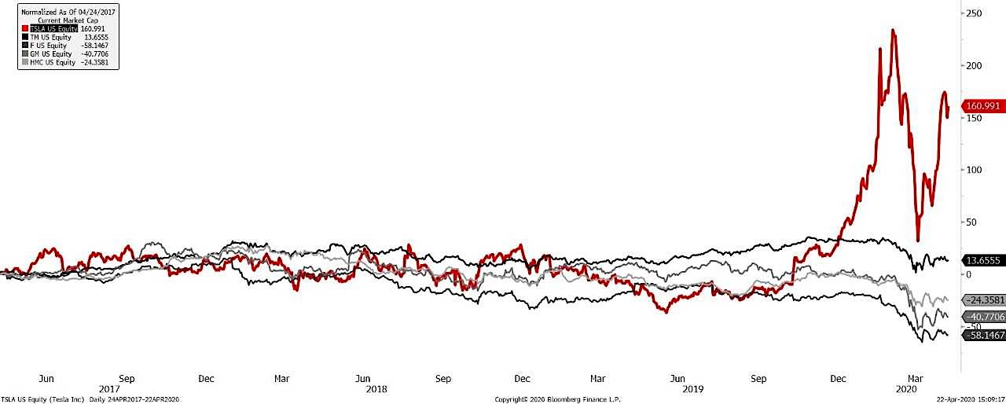
Industry Overview
Competitive Landscape
Despite lagging behind legacy automakers in total auto sales, Tesla holds over 30% of the global EV market share.
Tesla’s intangible assets and battery technology partially account for its stock performance relative to competitors.
Competition in the EV market is expected to intensify going forward.
U.S. Market Share Concentration 2019
Global 2019 EV Sales by Automaker
Historic Market Capitalization
TSLA
TM
F
GM
HMC

Slide 10
Table of Contents
Tesla Business Overview
Industry Overview
Macroeconomic Analysis
Tesla Credit Analysis
Appendix

Slide 11
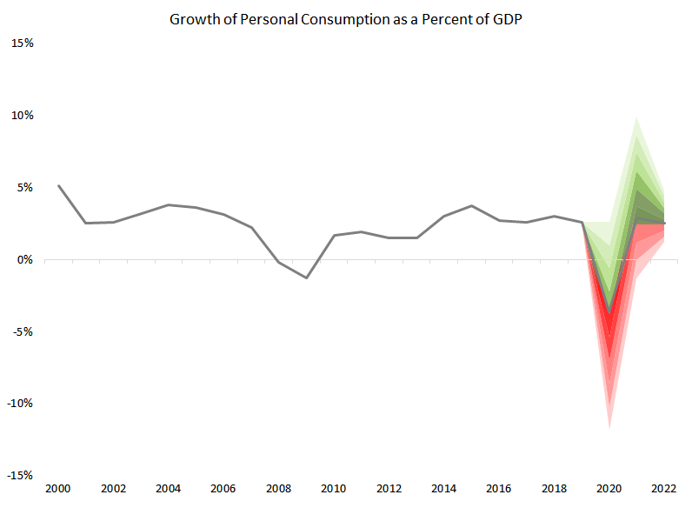
Macroeconomic Analysis
Economic Forecast
Prior to the onset of COVID-19 GDP growth and personal consumption as a percent of GDP was relatively stable. All estimates project contraction well into 2021 with recovery and greater upside potential by 2022.
Auto manufactures may benefit from depressed commodity prices.
Sharp increase in unemployment could negatively affect consumer demand for at least 18 months
U.S. GDP Growth
Personal Consumption as a Percent of U.S. GDP
¹
³
Commodity Prices
U.S. Unemployment
²
⁴
Sources: 1. Bloomberg 2. IMG 3. Bureau of Economic Analysis 4. Bloomberg

Slide 12
Macroeconomic Analysis
Consumer Confidence
U.S. Consumer Confidence Surveys
Leading Indicators Index
Personal Income Trends
¹
³
⁴
²
⁴
⁴
Sources: 1. Conference Board 2. University Michigan 3. Conference Board 4. Bureau of Economic Analysis

Slide 13
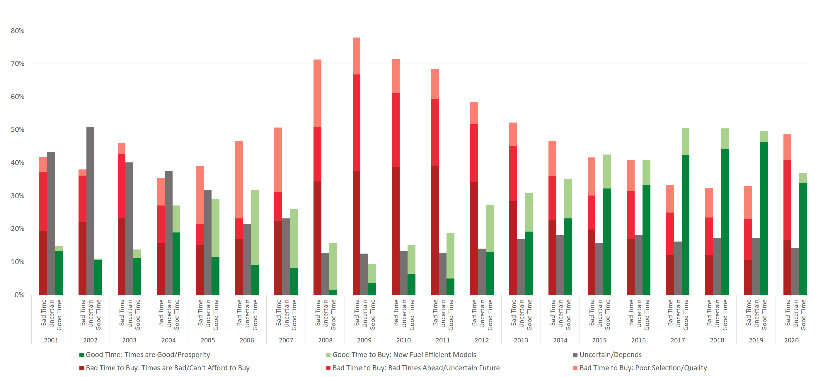
Macroeconomic Analysis
Consumer Sentiment Toward Automotive Purchases
TEXT
Source: University of Michigan Survey Data

Slide 14
Table of Contents
Tesla Business Overview
Industry Overview
Macroeconomic Analysis
Tesla Credit Analysis
Appendix

Slide 15
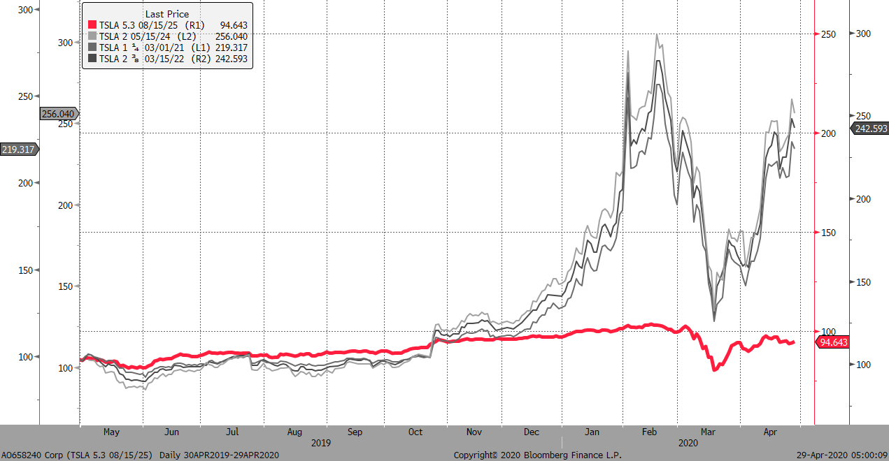
Credit Analysis
Bond Summary
TSLA 5.3% 8/15/2025
Outstanding Issues (Last Price)
Price: 94.287 Yield(Wst): 6.547 Issue Date: 08/18/2017 Maturity: 08/15/2025 Issue Amount: $1,800M Gaurantor: Tesla Energy Operations Inc. Rating: Moody's: Caa1 S&P: B- Rank: Senior Security: Unsecured Callable: Yes Make Whole @50 Until 08/15/20 8/15/20 @ 103.975 8/15/21 @ 102.65 8/15/23 @ 100

Slide 16
Credit Analysis
Investment Thesis
We place a BUY recommendation on Tesla’s 5.3% 2025 Note based on the following key drivers:
Sufficient cash reserves to withstand Coronavirus disruption
Technology lead in electrification provides flexibility to scale back capital expenditure
Debt maturing prior to 2025 will likely be refinanced or converted into equity

Slide 17
Credit Analysis
Key Driver I: Liquidity
Tesla is in a favorable cash position to forgo revenue without risking default.
We believe Coronavirus poses a low risk for Tesla bondholders, with available capital of 6.1B and operating expenses of 4.1B.
Tesla is better poised to forgo revenue than many competitors.
Liquid Capital($ in Billions)
Key Stats
Recent 8k quotes 3B in Credit Lines, 2.3B available from recent offering, and 6.3B in cash.
Excluding non-liquid funds & minimum cash balance, this leaves Tesla with 6.1B in liquid capital and 4.1B minimum operating expenses.
Available Cash / Operating Expenses

Slide 18
Credit Analysis
Key Driver II: Capital Expenditures
Tesla has a significant technology lead in the production of batteries.
This lead provides Tesla with more flexibility to scale back capital expenditures amidst Coronavirus disruption.
Battery Pack Cost per kWh
Battery Plant Capacity (Gigawatt Hours)
Competitors Play Catch-Up
Sustained Competitive Advantage
GM CEO recently claimed investing in batteries is an essential step to decrease battery costs and improve profitability of EV’s.
GM and LG Chem are spending $2.3 billion to build a new battery plant.
Toyota and Panasonic announced joint venture to develop prismatic battery packs.
“We believe this situation overall favors Tesla in the medium term as there would be less competition from higher quality electric vehicles and the disruption could inadvertently help sustain Tesla’s premium multiple”
-Armintas Sinkevicius, Morgan Stanley Analyst

Slide 19
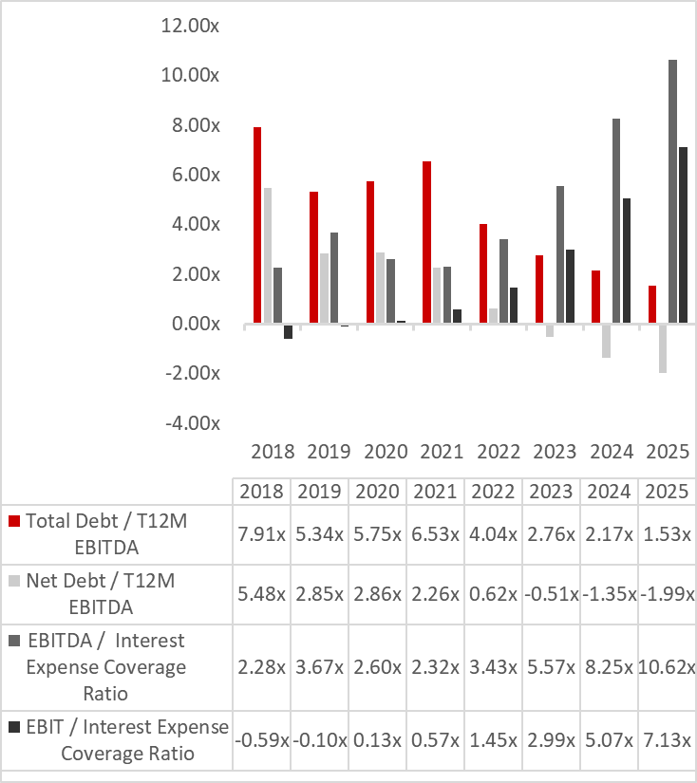
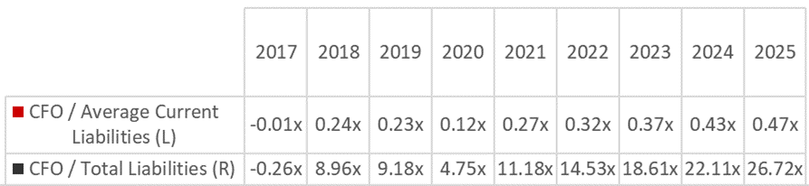
Credit Analysis
Key Driver III: Maturities and Conversions
Income
Cash Flow

Slide 20
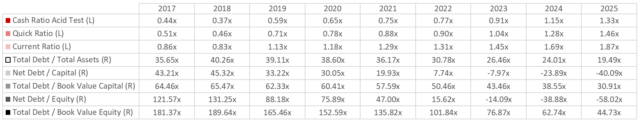
Credit Analysis
Key Driver III: Maturities and Conversions (cont.)
Balance Sheet
^{Historical Data: SEC Filings}

Slide 21
Credit Analysis
Key Driver III: Maturities and Conversions (cont.)
 | Conversion Price | Conversion Ratio
TSLA 1.25 03/01/2021 | $ 359.87 | 2.7788
TSLA 2.375 03/15/2022 | $ 327.50 | 3.0534
TSLA 2.00 05/15/2024 | $ 309.83 | 3.2276
Stock Price VS Conversion Prices
April, 2020 $ 686.72
May, 2021 $746
May, 2021 $342

Slide 22
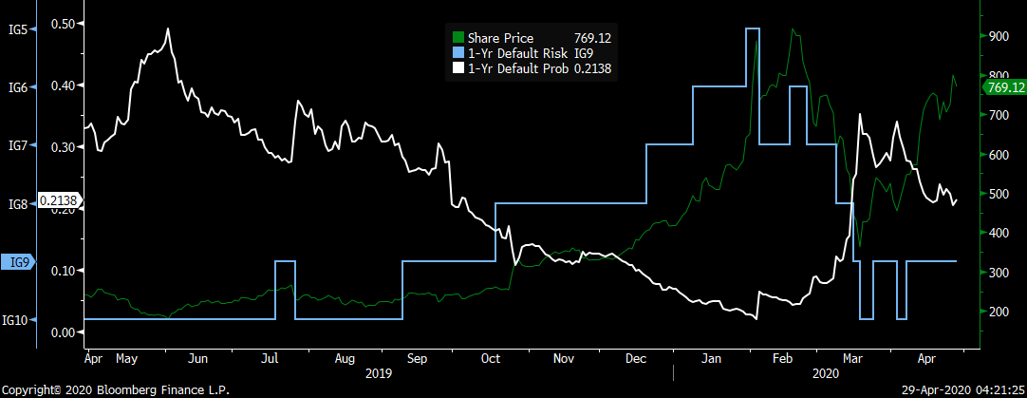
Credit Analysis
Default Risk Analysis
Bloomberg Default Probability

Slide 23
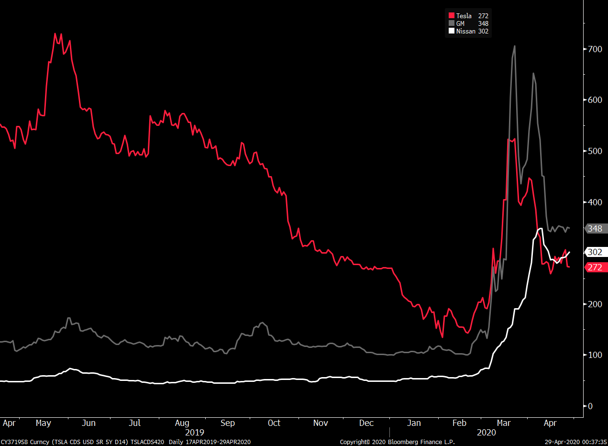
Credit Analysis
Default Risk Analysis
5 Year Senior Note CDS Spread Comparison

Slide 24
Credit Analysis
Recovery Analysis
($ in Millions) | Bear | Base | Bull
Enterprise Value | 68,479 | 79,839 | 141,180
Current Liabilities | 10,667 | 10,667 | 10,667
Long Term Debt | 11,634 | 11,634 | 11,634
Recovered Enterprise Value | 46,178 | 53,538 | 118,879
% Recovered | 67.43% | 70.59% | 84.20%
Automotive Sales

Slide 25
Credit Analysis
Analysis of Key Covenants
Limitation on Liens
Company or Domestic Restricted Subsidiaries will not incur any Lien on Principal Property unless Notes are equally and ratably secured. Subject to Permitted Liens
Change of Control
In the event of a "Change of Control Triggering Event" the notes will be redeemed at 101% of par
Ratings Trigger
In combination with a Change of Control Triggering Event, a decline in Ratings during a specified Ratings Decline Period will trigger an Offer to Purchase
Cross Default
Company may be in default should any of the notes of the Company or its "Significant Subsidiaries" default on at least $500M in principal
Limitation on Sale and Lease-back
Company or Domestic Restricted Subsidiaries may not enter any sale/lease-back transactions with respect to Principal Property. Some exceptions apply.
Limitation on Subsidiary Debt
Company will not permit any Domestic Restricted Subsidiaries (excluding Guarantor) from incurring indebtedness without also guaranteeing the Note

Slide 26
Credit Analysis
Covenant Comparables
Bond | Moody's Rating | Yield (To Worst) | Maturity | Rank | Negative Pledge | Change of Control | Cross Default | Ratings Trigger | Limitation on Sale-Leaseback | Limitation on Subsidiary Debt
Tesla Inc. 5.3 | Caa1 | 6.547 | 8/15/2025 | Sr. Unsecured | Yes | Yes | Yes | Yes | Yes | Yes
Ford 4.271 | Ba2 | 6.83 | 1/9/2027 | Sr. Unsecured | Yes | No | No | No | No | No
Meritor 6 1/4 | B1 | 6.73 | 2/15/2024 | Sr. Unsecured | Yes | Yes | No | No | Yes | No
Cooper Tire & Rubber 7 5/8 | B1 | 7.02 | 3/15/2027 | Sr. Unsecured | Yes | No | Yes | No | Yes | No

Slide 27
Credit Analysis
Risks
Liquidity Risk
Capital Expenditure Risks
Debt Repayment Risks
Inability to Cover Expenses
Lose Advantage in Core Tech
Capital Markets
If COVID-19 prevents Tesla from generating revenue for more than 1.5 years, this could impair their ability to cover expenses.
If Tesla reduces CapEx while their competitors are increasing it, it is possible that they will lose their strategic advantage in core EV technologies.
Tesla’s ability to refinance debt is dependent on the state of capital markets and their financial position at the time. If their stock price drops below the conversion price, Tesla won’t be able to fulfill their debt obligations with equity.
Movement of Capital to Non-liquid Accounts
Consumer Preferences
If Tesla decides to move currently liquid capital to non-liquid accounts such as foreign markets, leasing contracts, or contracts with suppliers, this could limit their ability to cover expenses without generating additional revenue.
If customers don’t value the advantages of Tesla’s tech, they may not have leeway to cut CapEx and instead be forced to make strategic investments in the areas that competitors lead.
Accelerated Repayment
Changes in business and economic conditions could cause Tesla to obtain additional debt financing that break their covenants. This could result in default and permit holders to accelerate obligations to repay debt at a time that Tesla does not have sufficient funds to repay it.
Liability Claims
If Tesla is not able to defend or insure against liability claims, its financial condition and liquidity could be threatened.
Inability to Reissue
Supplier Contracts
If Tesla loses its favorable position in the market, they may not be able to reissue their debt at their current rates.
Tesla is has entered into volume contracts with several of its key suppliers, and if they don’t meet their demand projections they will be forced to keep buying parts/producing vehicles they cannot sell.
Lease-End Projections
The profitability of vehicles returned to Tesla at the end of their leases depends on the accurate projection of residual value. Changes in demand for used vehicles could compromise leasing profitability.
Resale Guarantees
Tesla provided resale value guarantees to customers under certain financing programs in which vehicles may be sold back to the company for a predetermined price. The profitability of these buy-back agreements is dependent on projecting residual value of vehicles.
Tesla may be forced to break certain covenants that interfere with their ability to operate, such as incurring debt, issuing guaruntees, liens, stock repurchases, or certain voluntary debt repayments. Failure to comply with any covenants could result in default and permit holders to accelerate obligations to repay debt at a time that Tesla cannot produce the required capital.

Slide 28
Conclusion
Key Driver I
Key Driver II
Key Driver III
Sufficient cash reserves to withstand Coronavirus disruption
Technology lead in electrification provides flexibility to scale back capital expenditure
Debt maturing prior to 2025 will likely be refinanced or converted into equity
Recommendation
We place a BUY recommendation on Tesla’s 5.3% 2025 Note.

Slide 29
Table of Contents
Tesla Business Overview
Industry Overview
Macroeconomic Analysis
Tesla Credit Analysis
Appendix

Slide 30
Appendix
Discounted Cash Flow Valuation
 |  |  |  | 2020E | 2021E | 2022E | 2023E | 2024E | 2025E
Revenue |  |  |  | 23,387 | 26,855 | 31,141 | 35,889 | 41,559 | 48,165
Y-o-Y % change |  |  |  | - | 14.83% | 15.96% | 15.25% | 15.80% | 15.90%
Operating Income (EBIT) |  |  |  | 216 | 625 | 1,397 | 2,381 | 3,569 | 5,068
less: Taxes |  |  |  | 0 | 0 | 152 | 408 | 700 | 1,045
plus: Depreciation & amortization |  |  |  | 2,156 | 2,580 | 2,820 | 3,092 | 3,399 | 3,737
Gross Cash Flow |  |  |  | 2,372 | 3,204 | 4,065 | 5,065 | 6,269 | 7,760
Y-o-Y % change |  |  |  | - | 35.08% | 26.84% | 24.60% | 23.78% | 23.79%
Capital expenditures |  |  |  | -1,327 | -1,460 | -1,606 | -1,766 | -1,943 | -2,137
plus: change in working capital |  |  |  | -1,161 | 802 | 747 | 842 | 1,006 | 1,179
Total Investment |  |  |  | -2,488 | -658 | -858 | -924 | -936 | -958
Free Cash Flow to Firm |  |  |  | -116 | 2,546 | 3,206 | 4,140 | 5,332 | 6,802
Terminal Value at Year 6 |  |  |  |  |  |  |  |  | 101,157
Discount Period |  |  |  | 1 | 2 | 3 | 4 | 5 | 6
Discount Factor |  |  |  | 0.92 | 0.84 | 0.78 | 0.71 | 0.65 | 0.60
Present Value of Cash Flows |  |  |  | -106.31 | 2,148.77 | 2,485.38 | 2,948.22 | 3,488.18 | 4,087.52
Valuation |  |  |  | Assumptions |  |  | WACC Calculation
Present value of cash flows |  | 15,051.75 |  | WACC | 8.86% |  | Risk free rate (10 yr bond) |  | 0.65%
plus: PV of terminal value |  | 60,787.72 |  | Terminal growth rate | 2.00% |  | Beta |  | 1.40
Total enterprise value |  | 75,839.48 |  | Share Count | 181 |  | Equity Risk premium |  | 6.16%
plus: Cash & cash equivalents |  | 6,642.89 |  |  |  |  | Cost of debt |  | 6.50%
minus: Debt |  | 13,060.68 |  |  |  |  | Tax |  | 23%
Equity value |  | 69,421.68 |  |  |  |  | Cost of equity (CAPM) |  | 9.27%
 |  |  |  |  |  |  | After tax cost of debt |  | 5.01%
 |  |  |  |  |  |  | Capital Structure |  | 137,949.49
 |  |  |  |  |  |  | Equity |  | 124,530
 |  |  |  |  |  |  | Debt |  | 13,419

Slide 31
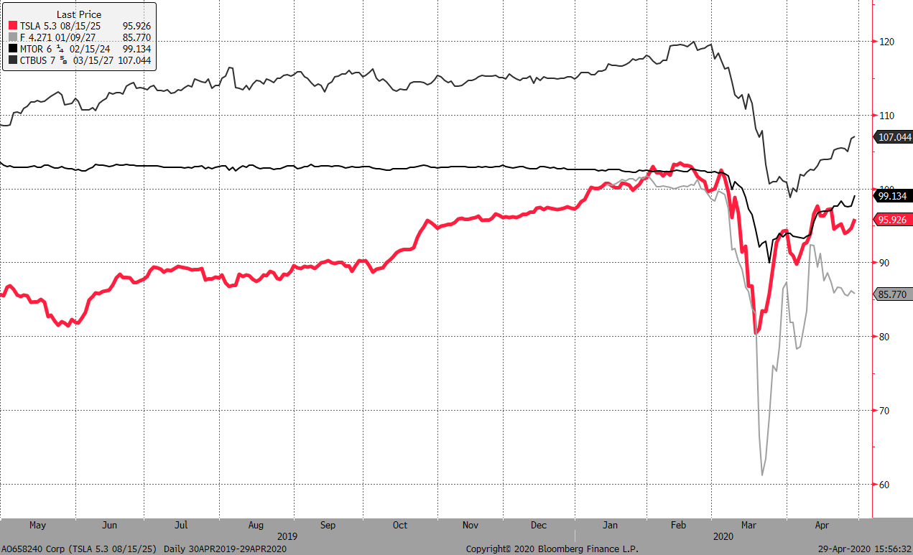
Appendix
Comparable Bond Prices
1 Year Time Series (Prices as of 4/29/20)

Slide 32
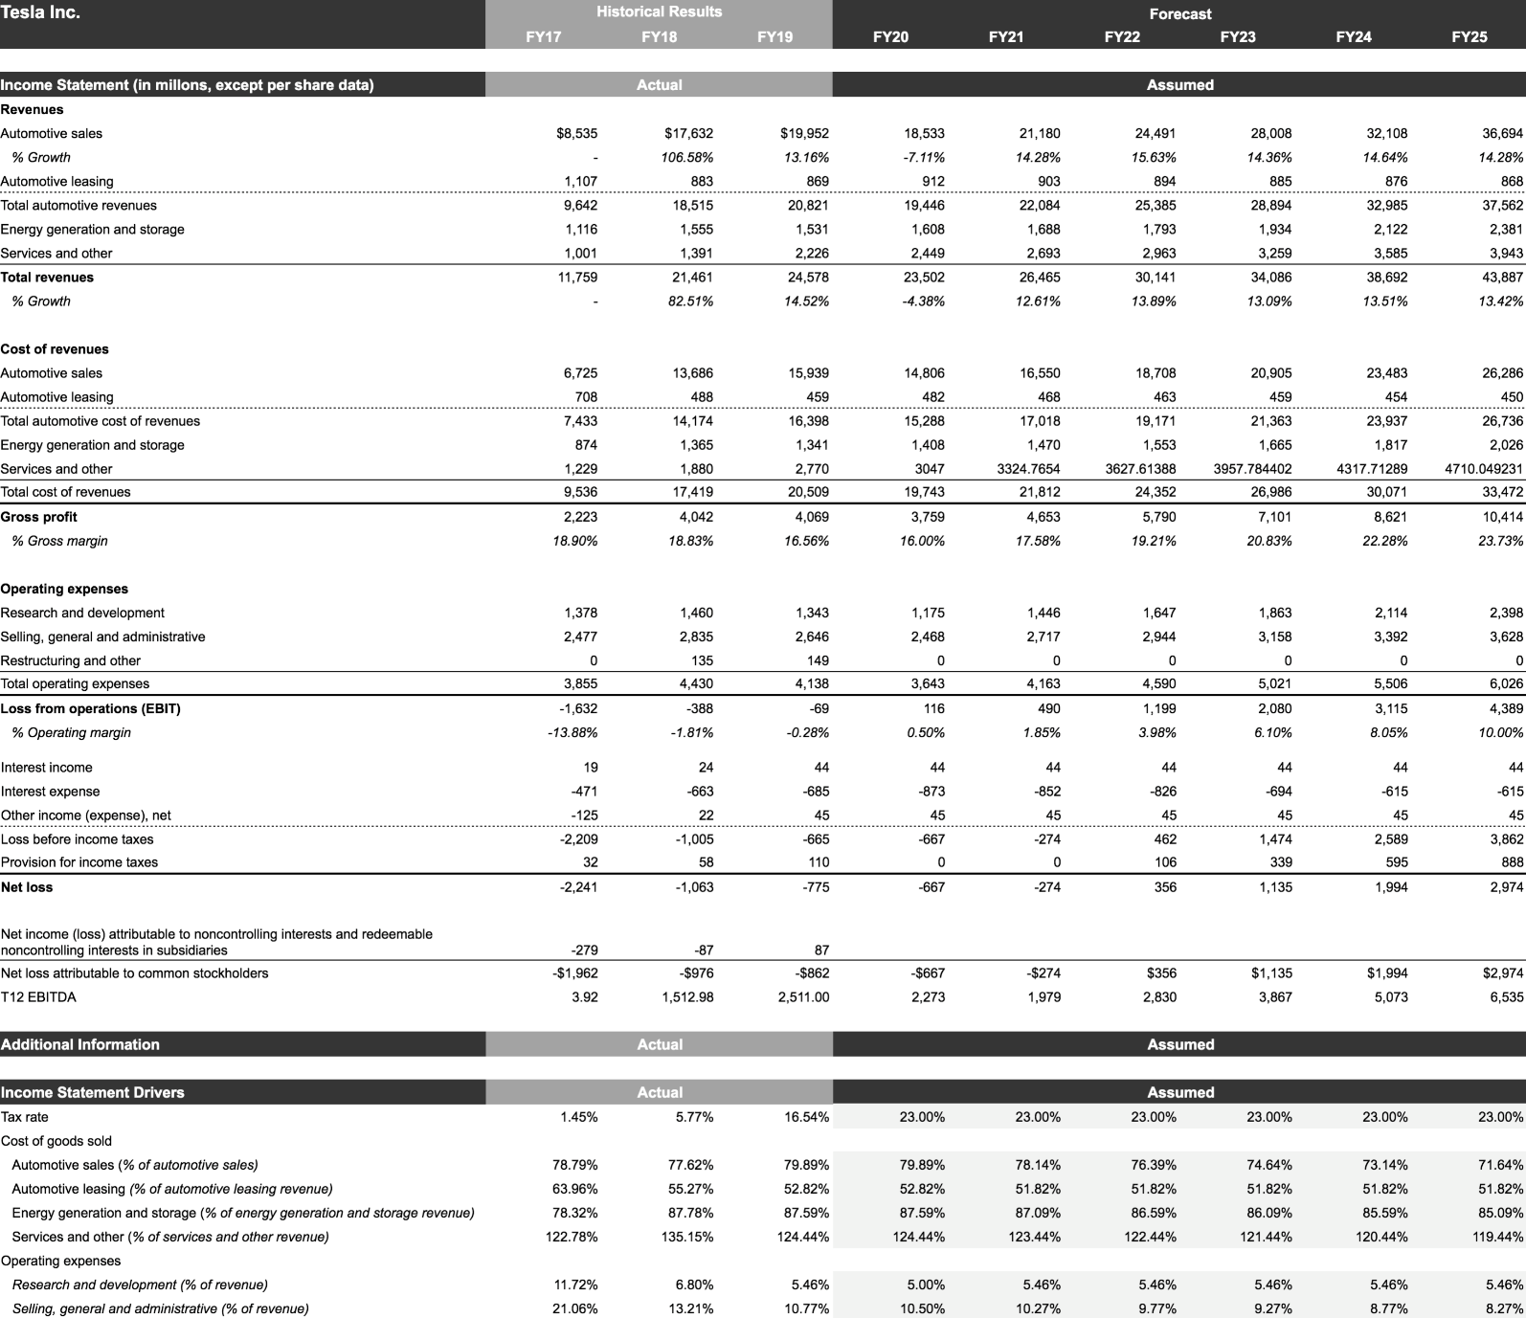
Appendix
Income Statement

Slide 33
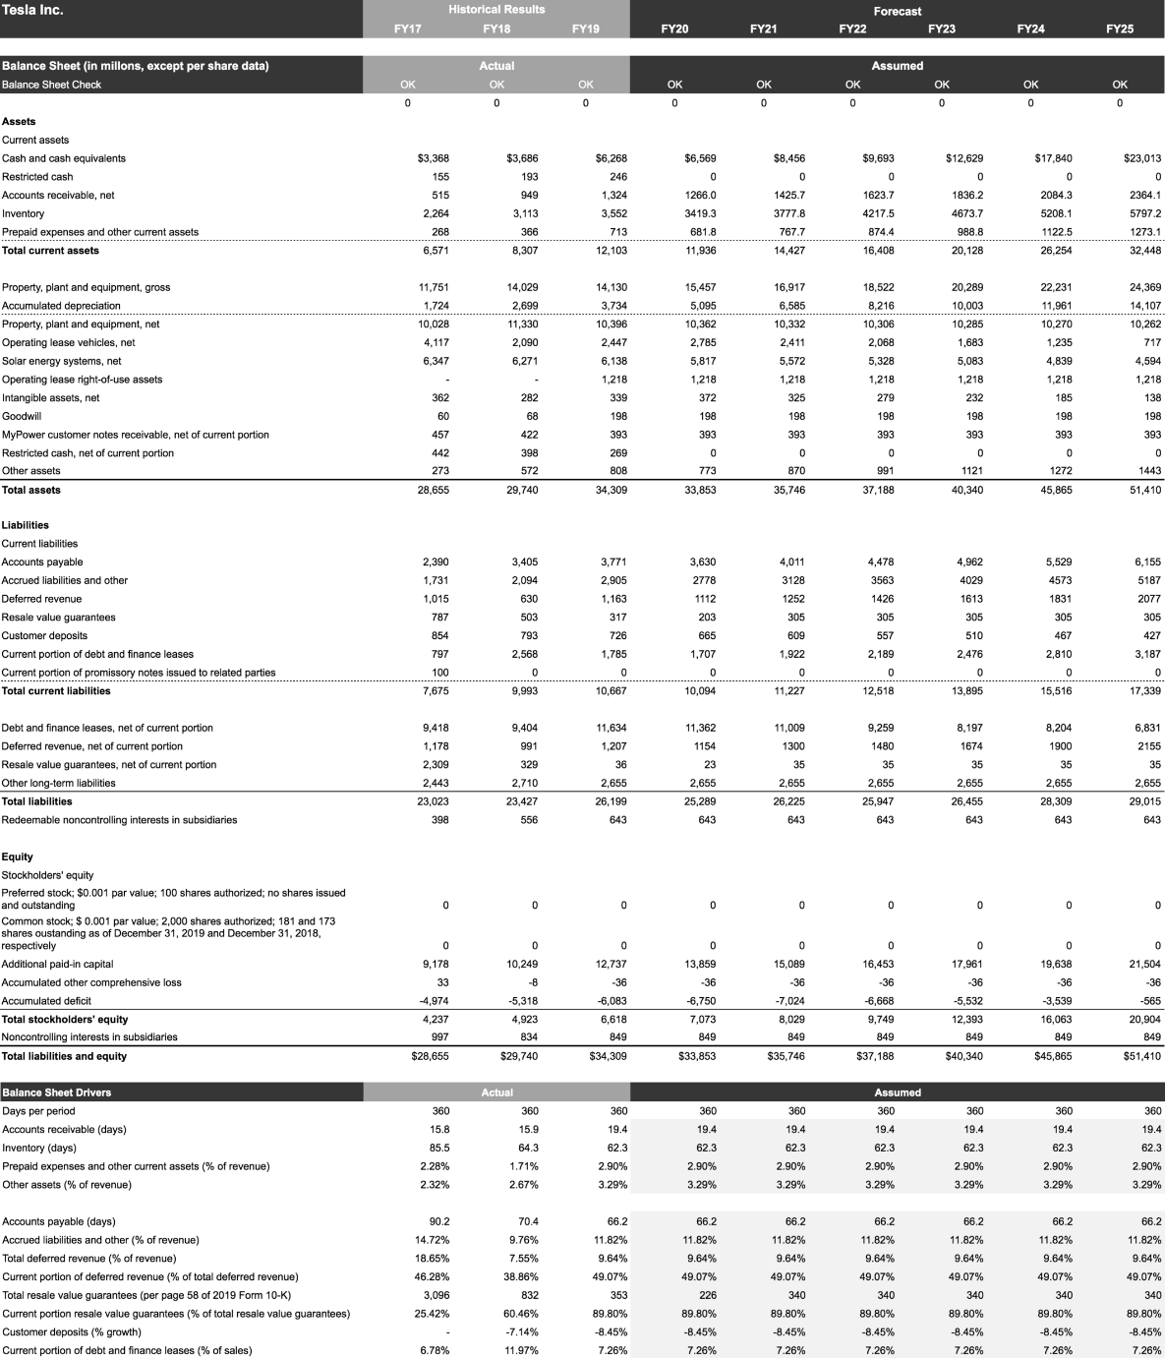
Appendix
Balance Sheet

Slide 34
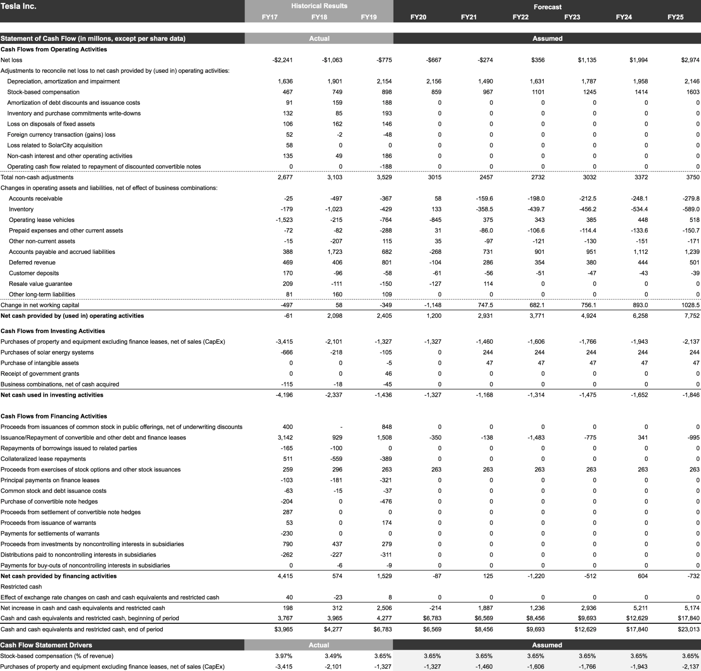
Appendix
Statement of Cash Flows

Slide 35
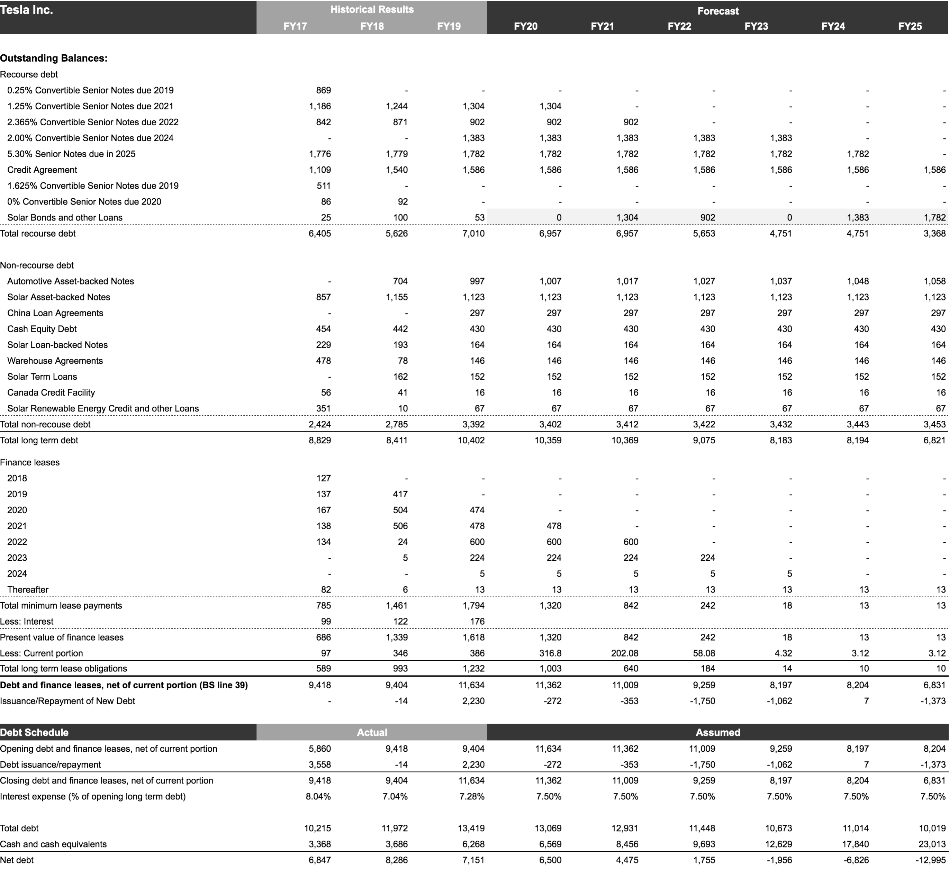
Appendix
Debt Schedule

Slide 36
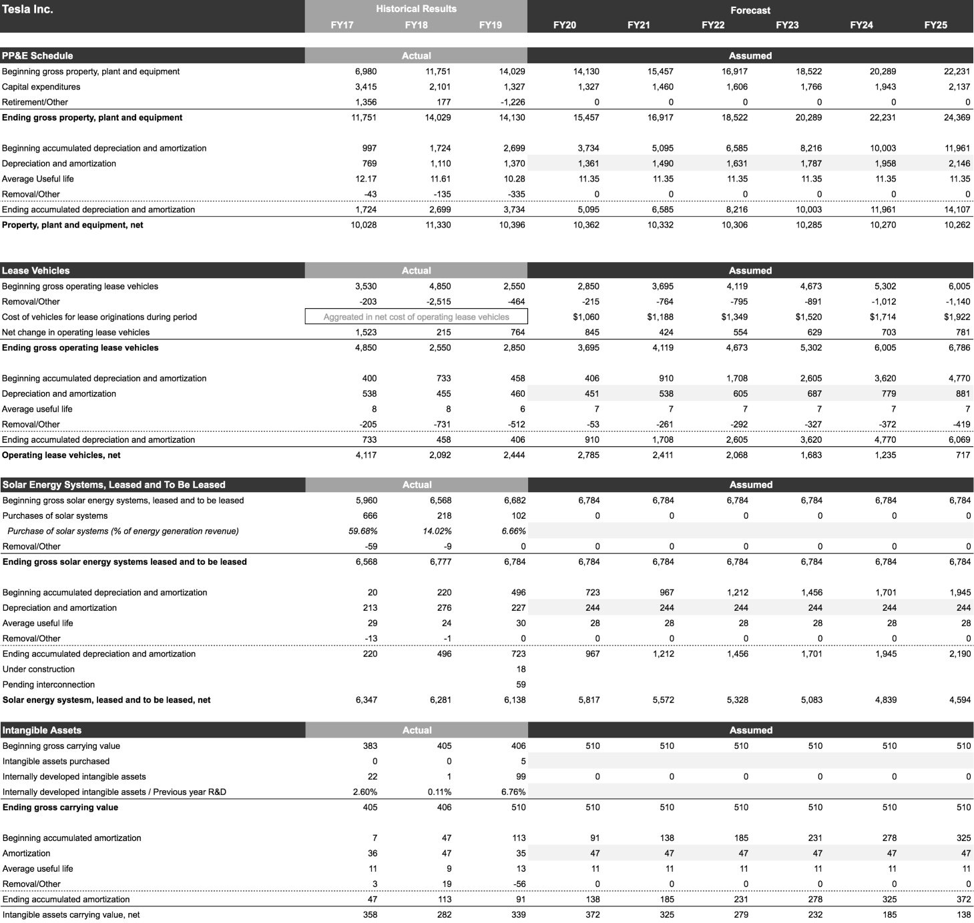
Appendix
Supporting Schedules

Slide 37
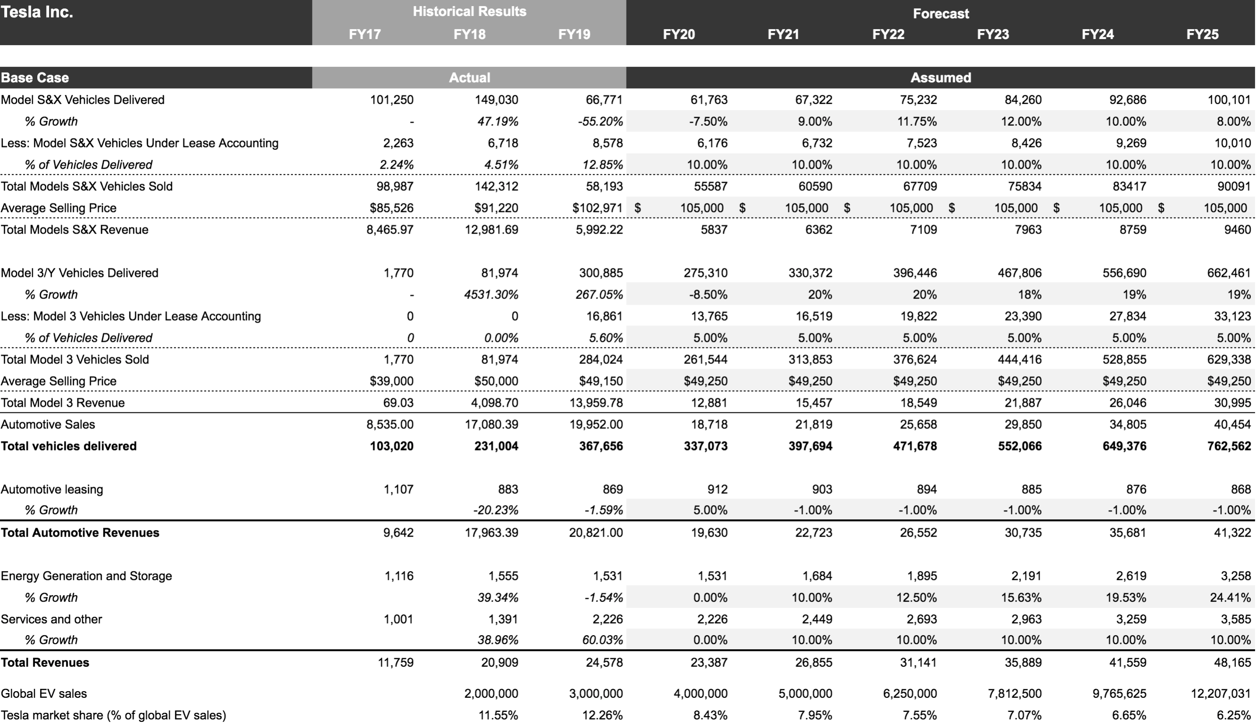
Appendix
Revenue Model

Slide 38
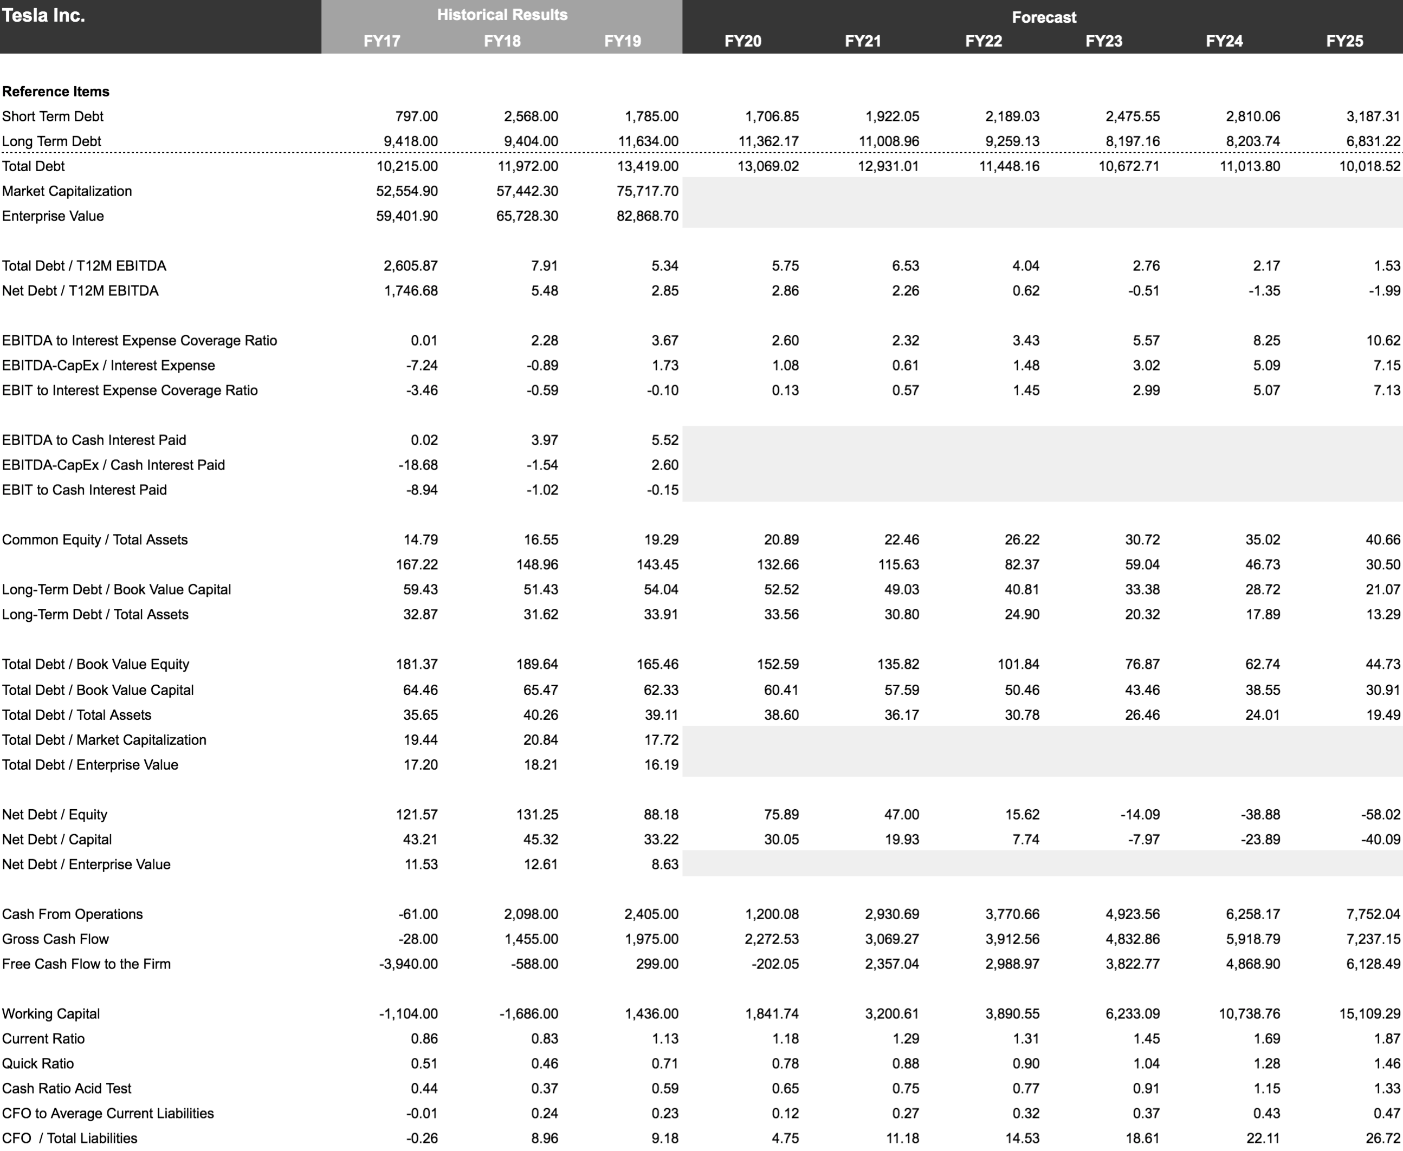
Appendix
Ratios

